Slide 1


Slide 2
Professor & Lawyer
Puttu Guru Prasad
B.Com., M.Com., M.Phil., M.B.A., PGDFTM., AP.SET., M.Phil., DRMS., L.L.B.,
ICFAI TMF., DIRM., LL.M., Pre PhD (PhD)from JNTUK., Topper
Domain Topper & 30th Batch Topper at ICFAI -2009 (TMF) LL.M Degree with Distinction & First Class from ANU-2019
“Diploma in Psychology from YALE University”
MHRDI’s 'Institution's Innovation Council (IICs)Ambassador
NSS Certified Program Officer, (A.U)
LL.B Degree Gold Medallist from ANU-2005
ICFAI UNIVERSITY Trained Senior MBA Faculty
Eminent Faculty for Accounts, Business Studies, Economics,
Head, Board of Administration & Management Science,
BHAGAVAD GITA & CLAT & IPMAT Program Coordinator,
Commerce Department, VIVA-VVIT, Nambur,
My Blog: puttuguru.blogspot.in My Web Site: https://gurublogs.wixsite.com/guru
93 94 96 98 98, 9885 96 36 36, 807 444 9539,

Slide 3
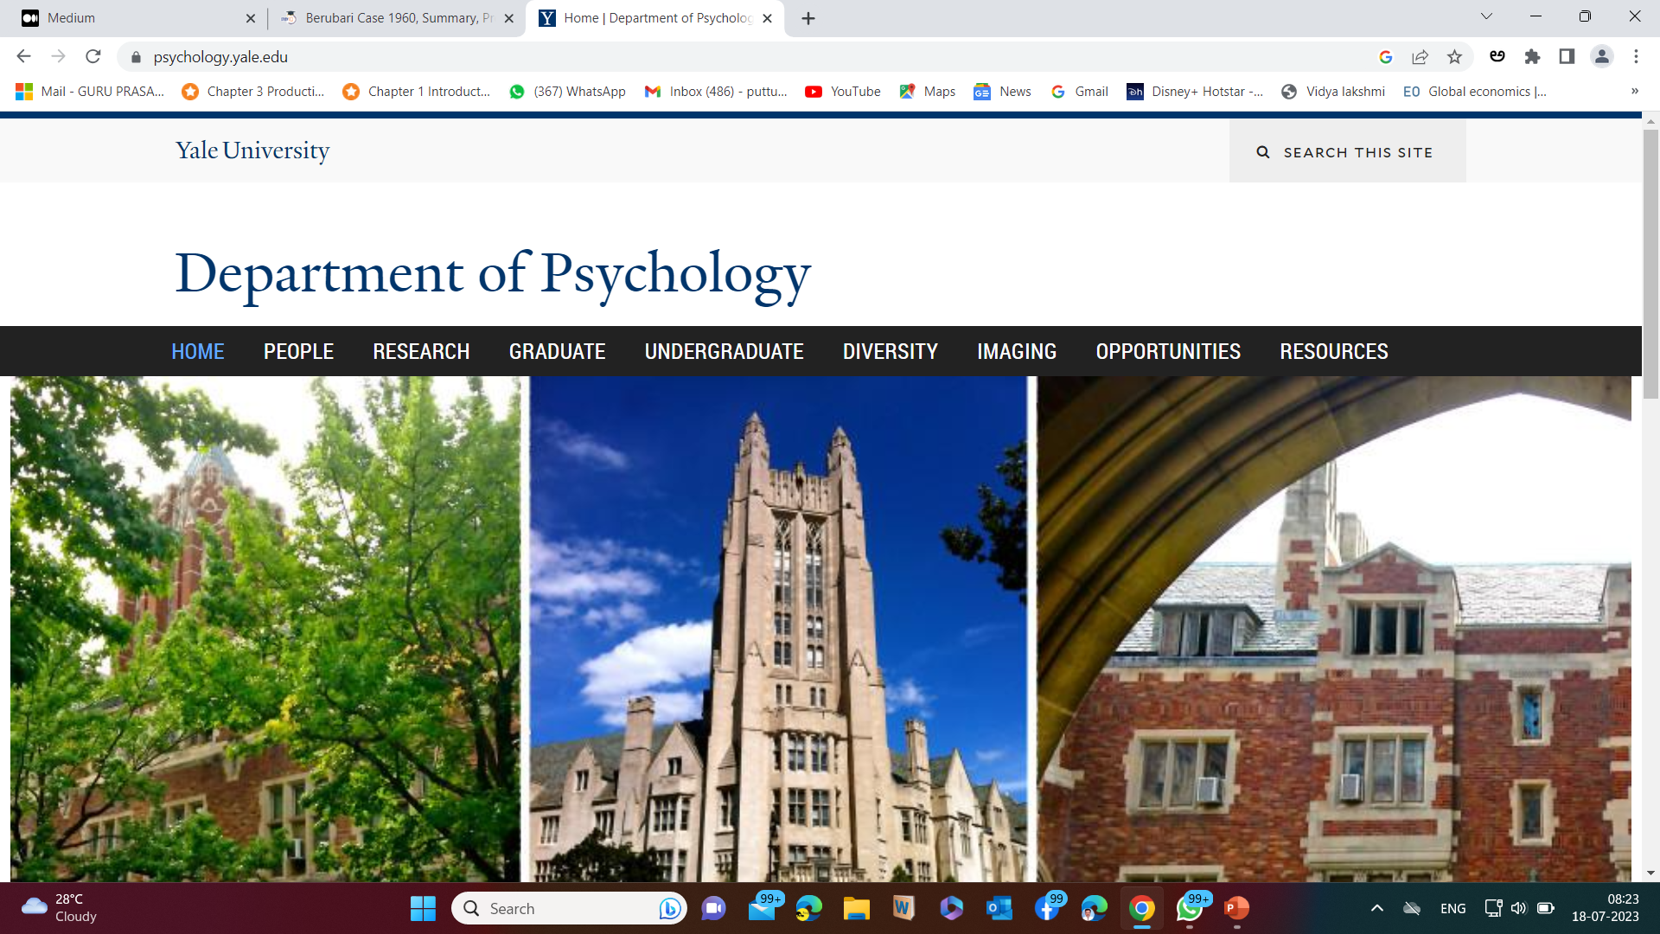
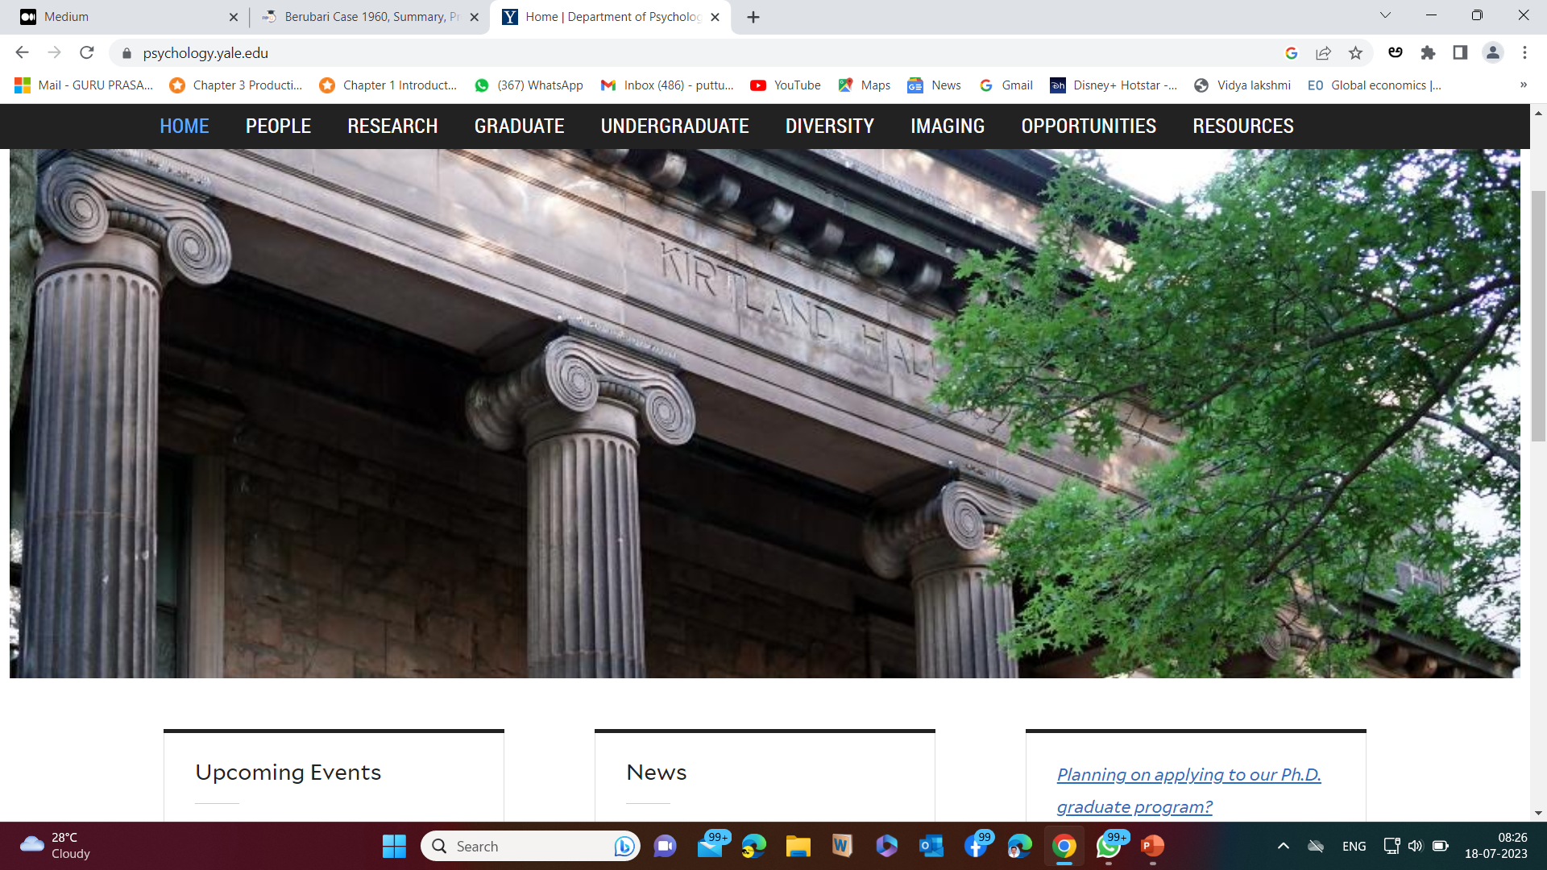
Department of Psychology, Yale University, 2 Hillhouse Ave, New Haven, CT 06520-8205, Connecticut, USA

Slide 4



Slide 5


Slide 6
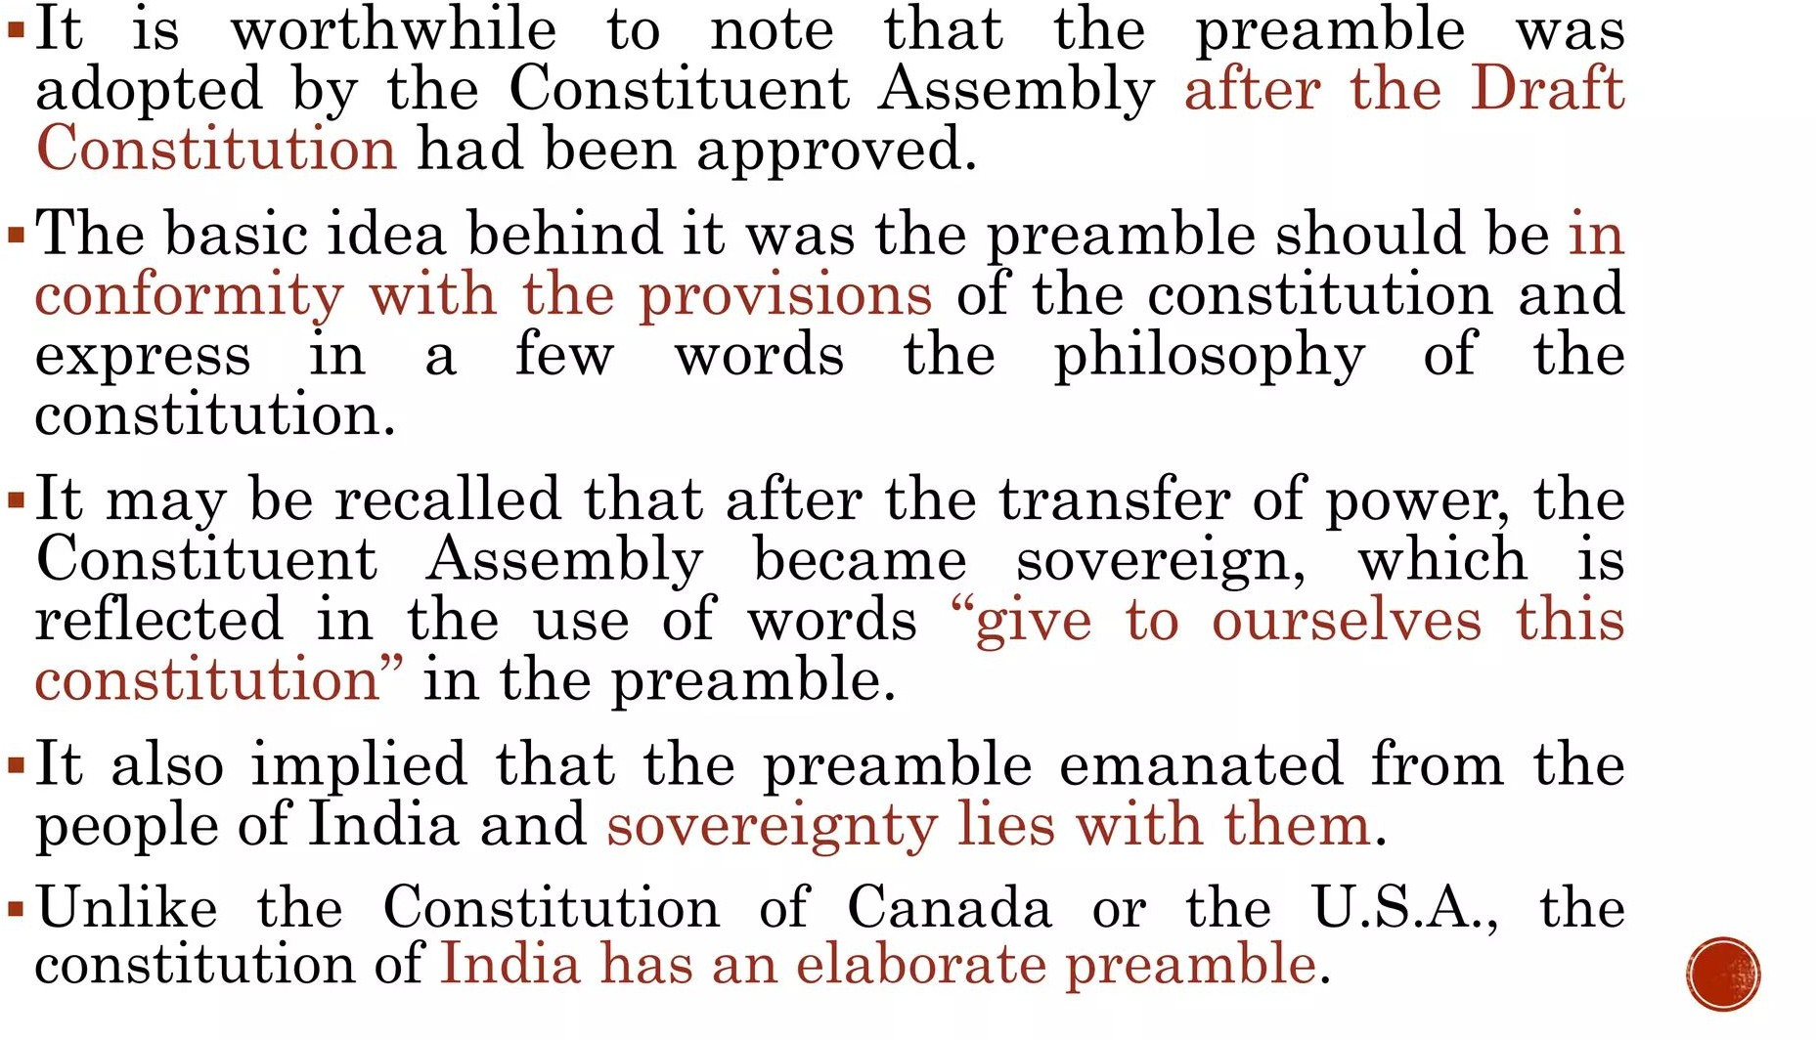

Slide 7
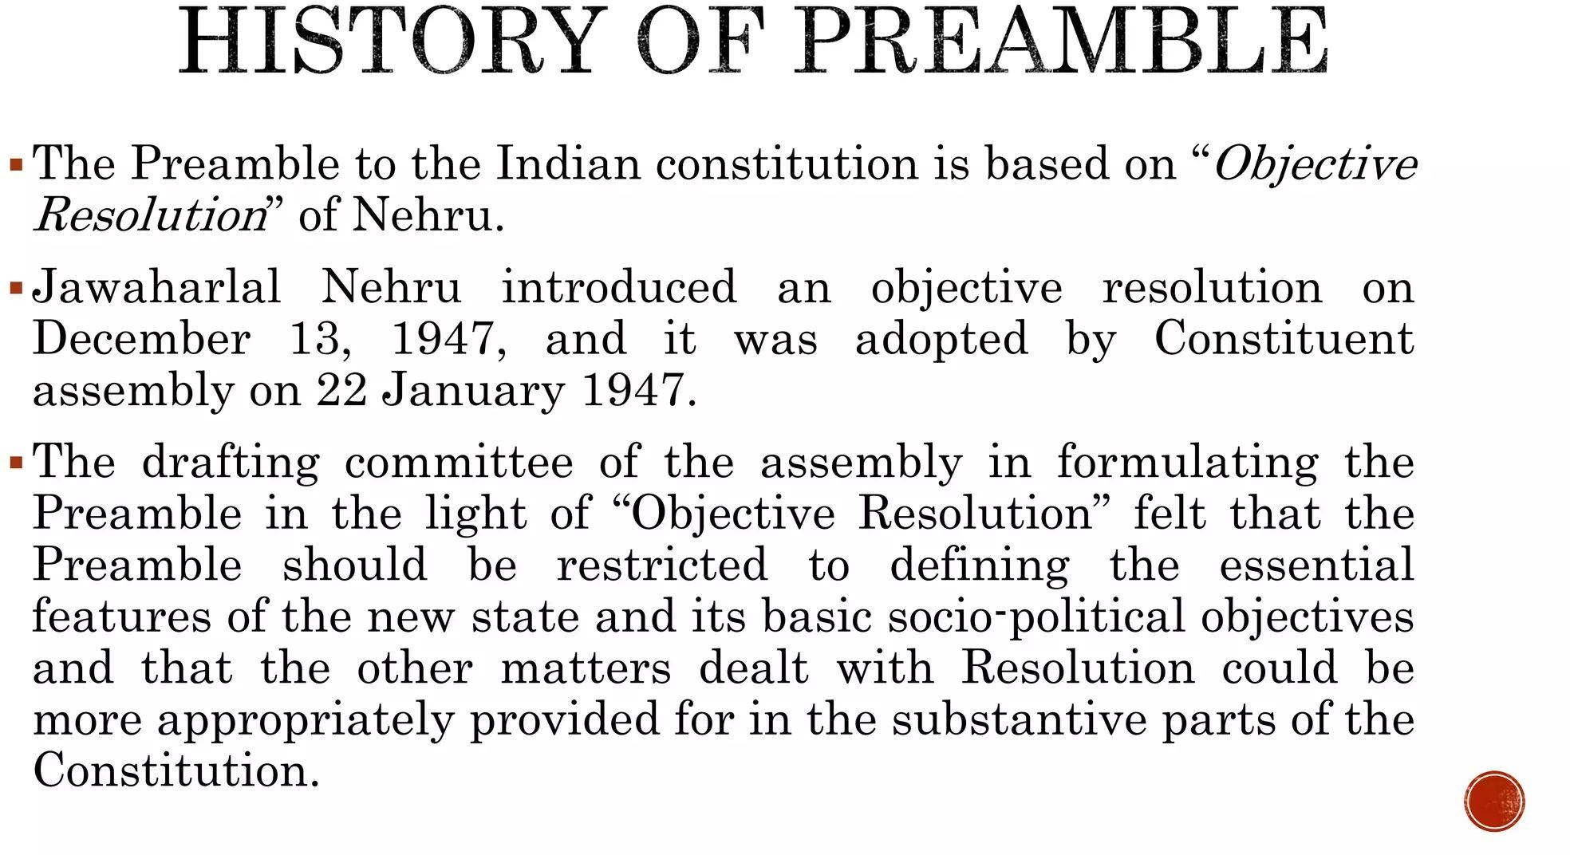

Slide 8
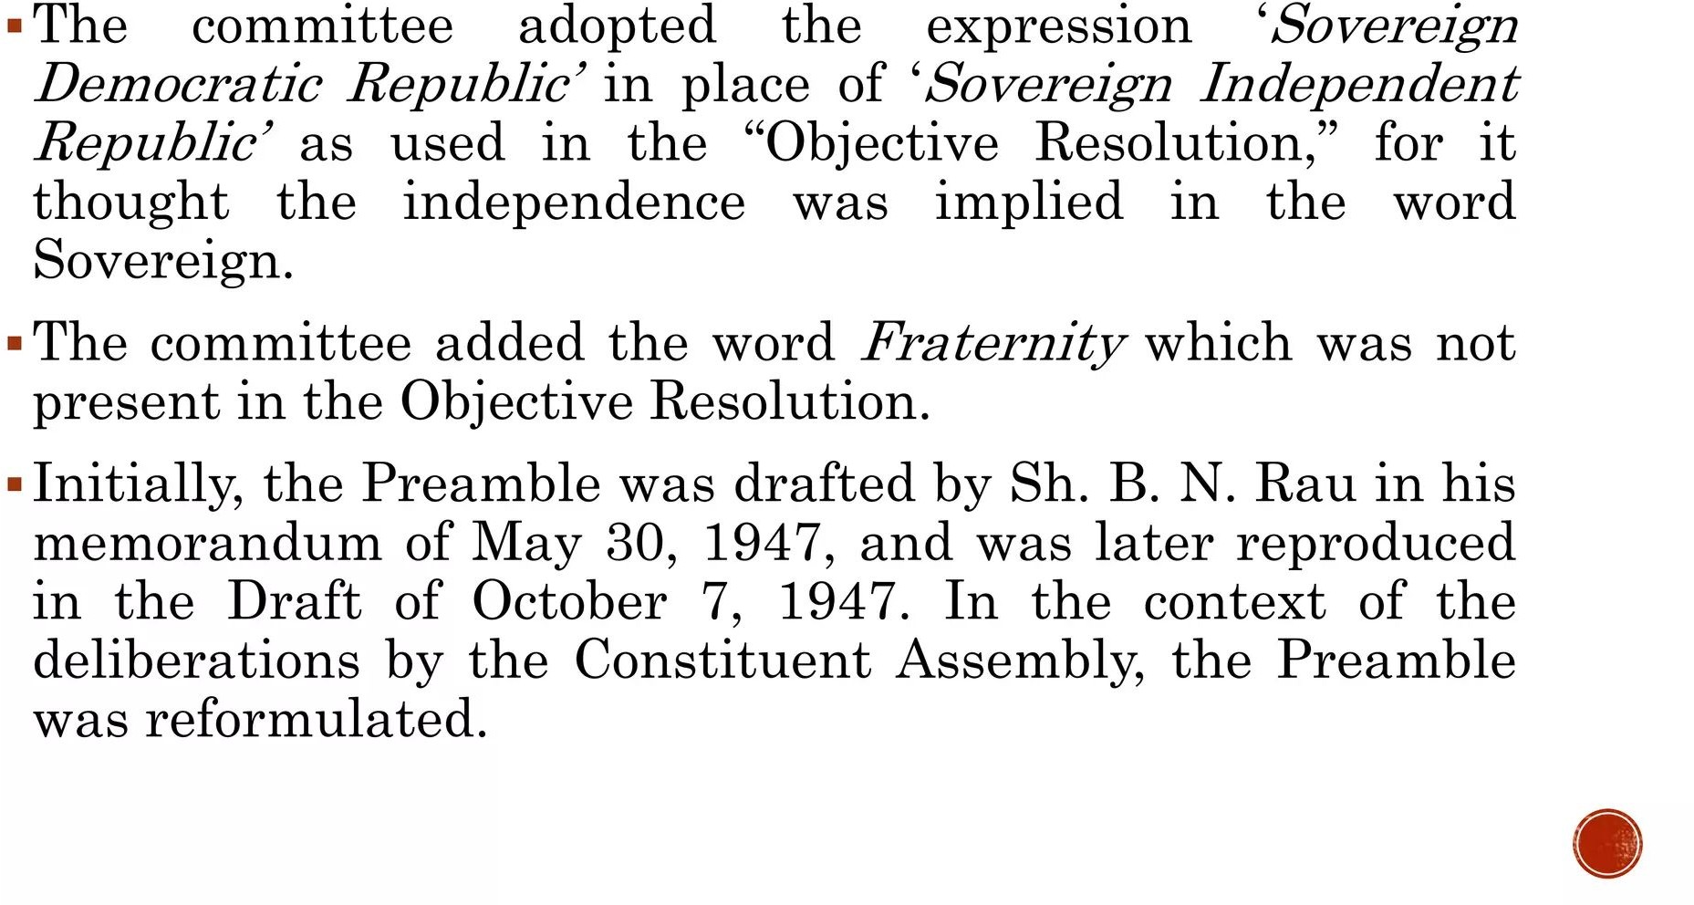

Slide 9


Slide 10
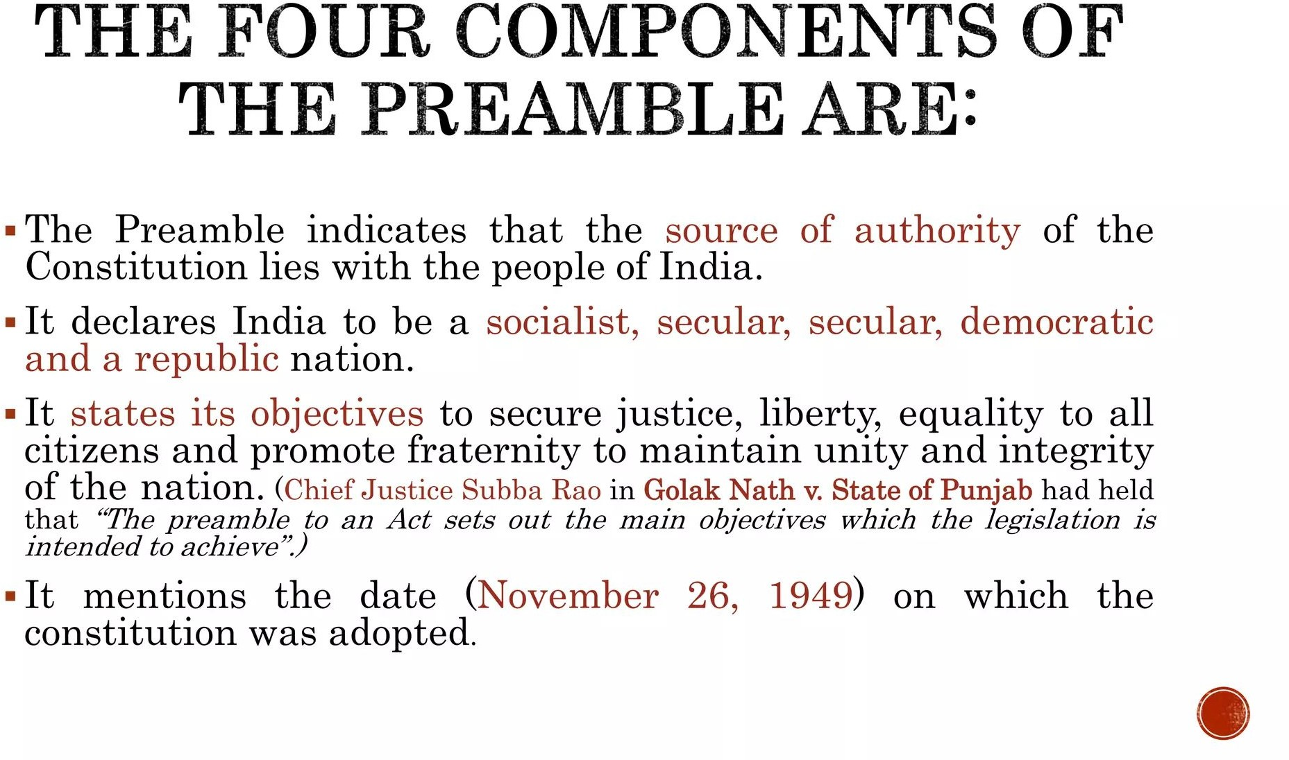

Slide 11
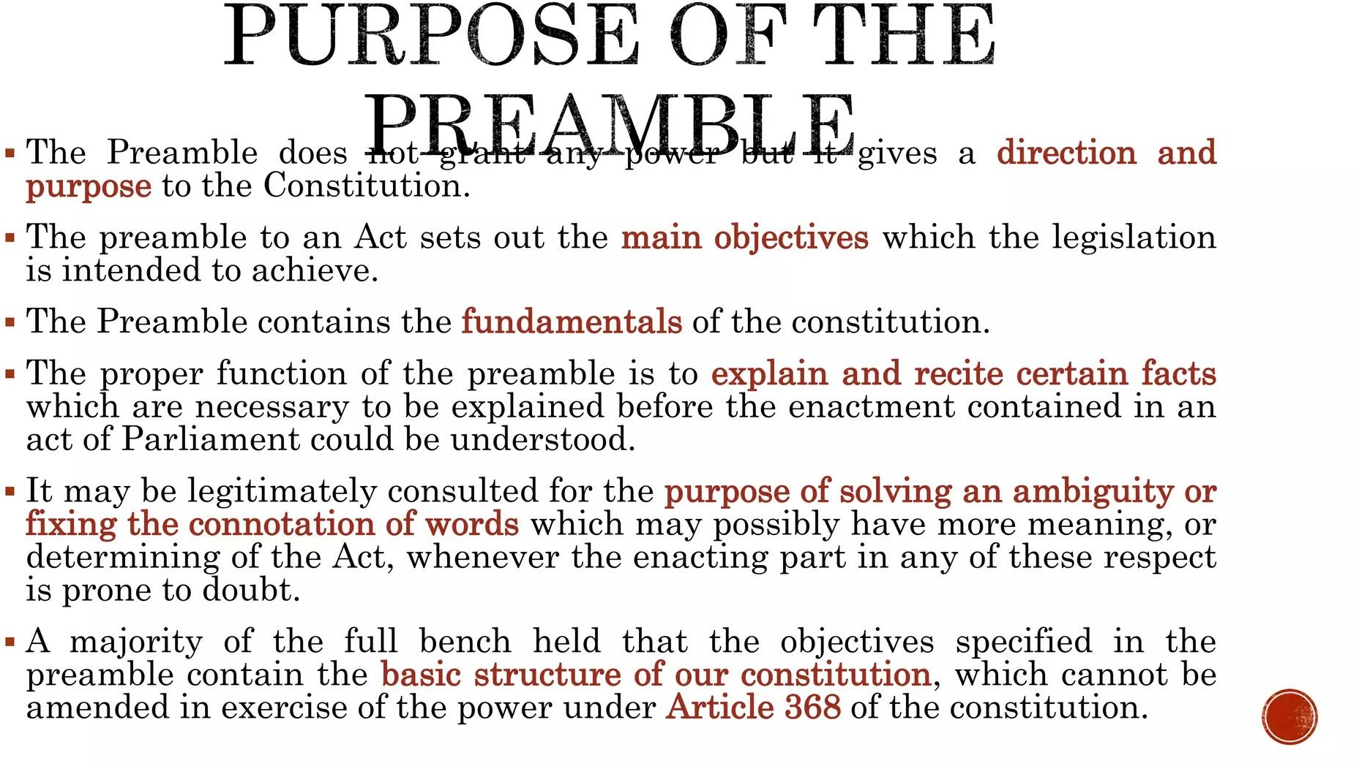

Slide 12
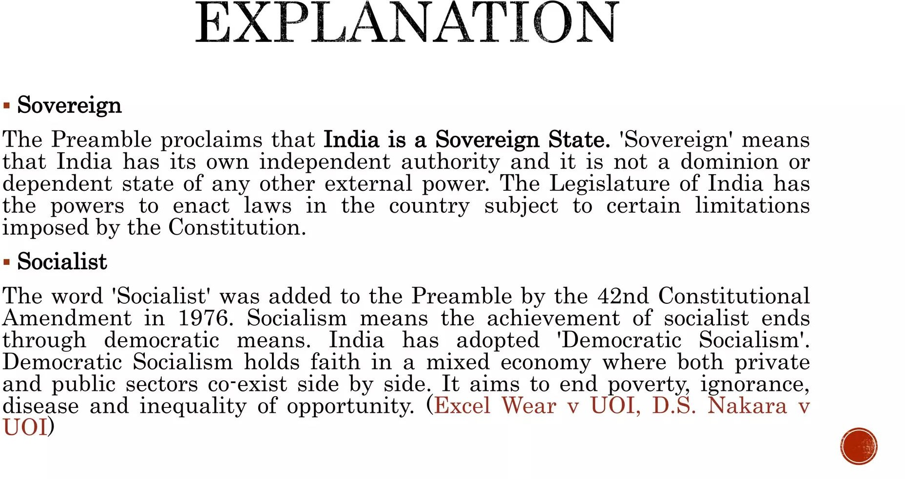

Slide 13
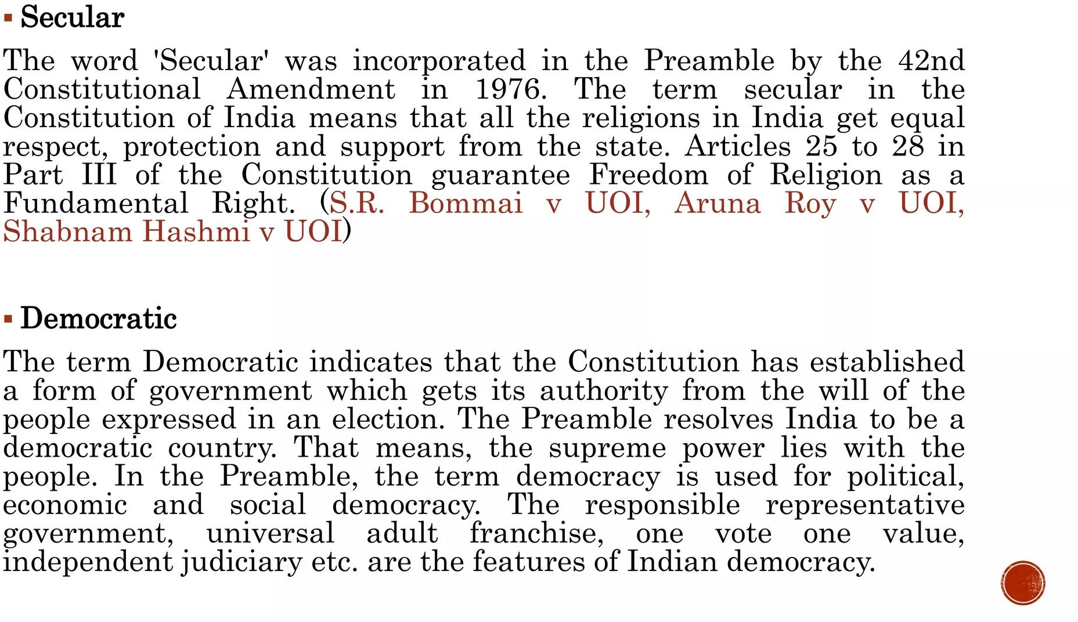

Slide 14
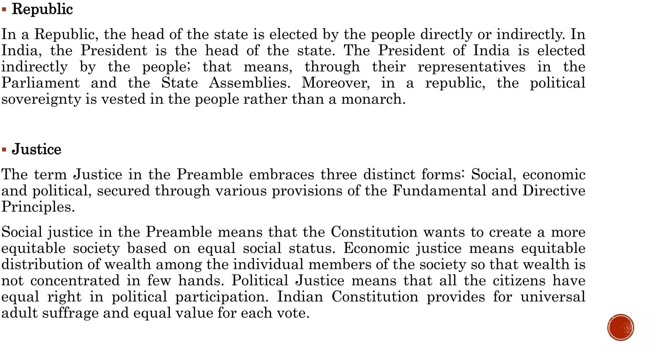

Slide 15
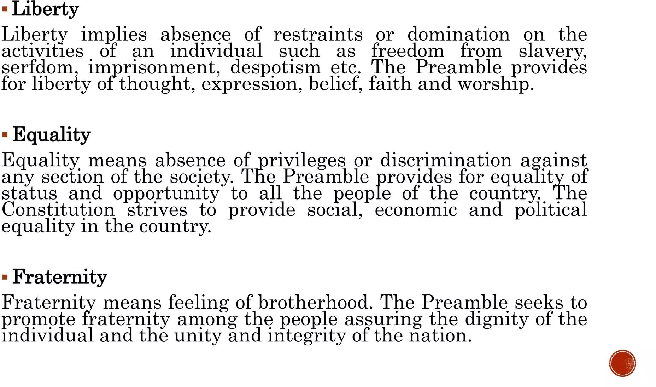

Slide 16


Slide 17
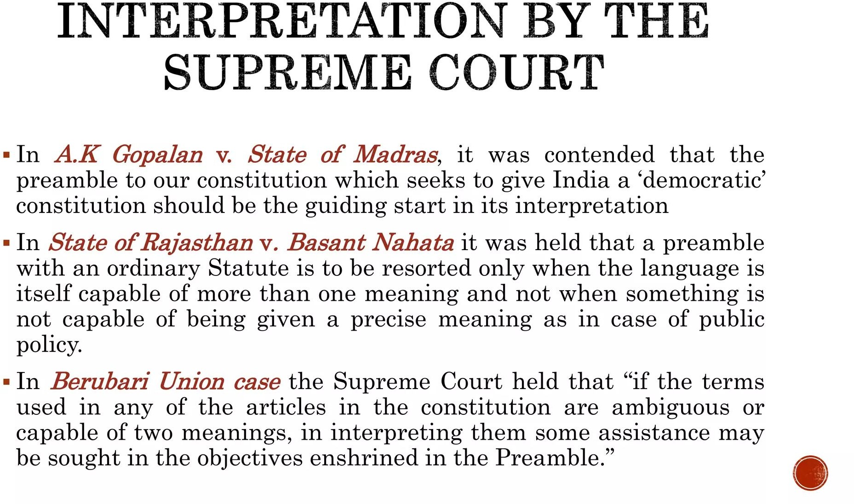

Slide 18


Slide 19
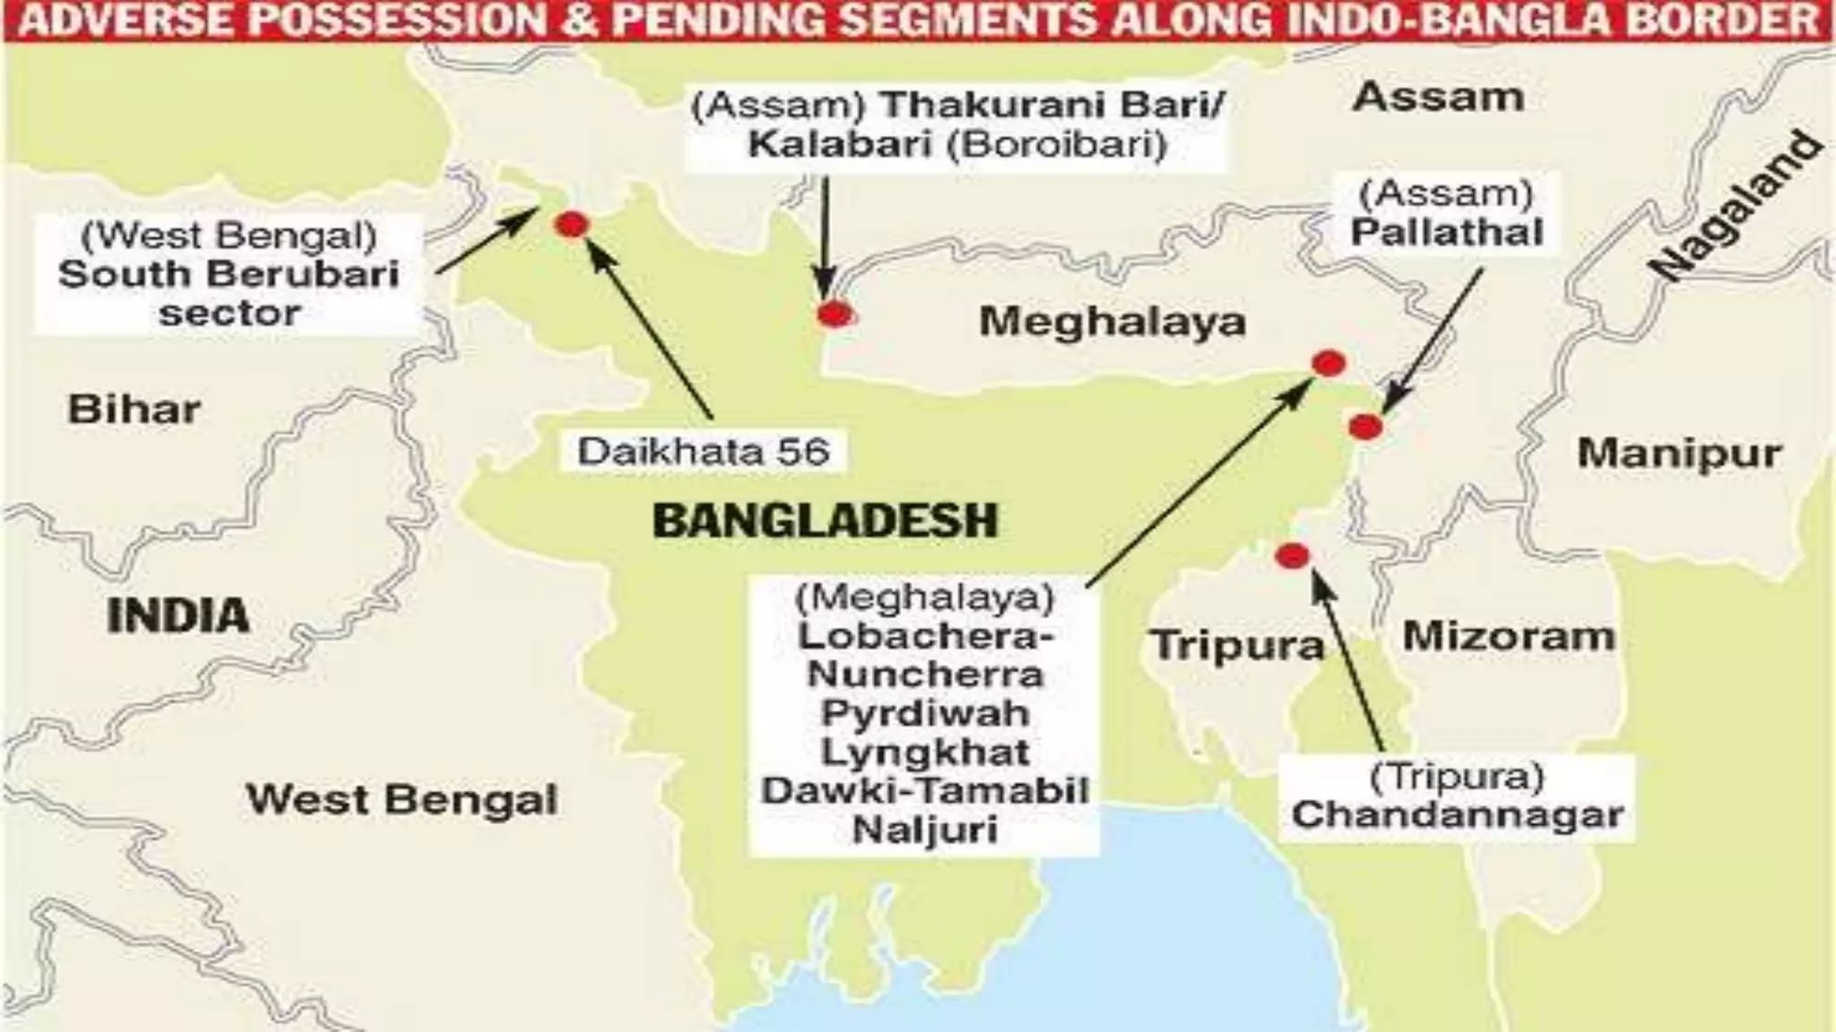

Slide 20
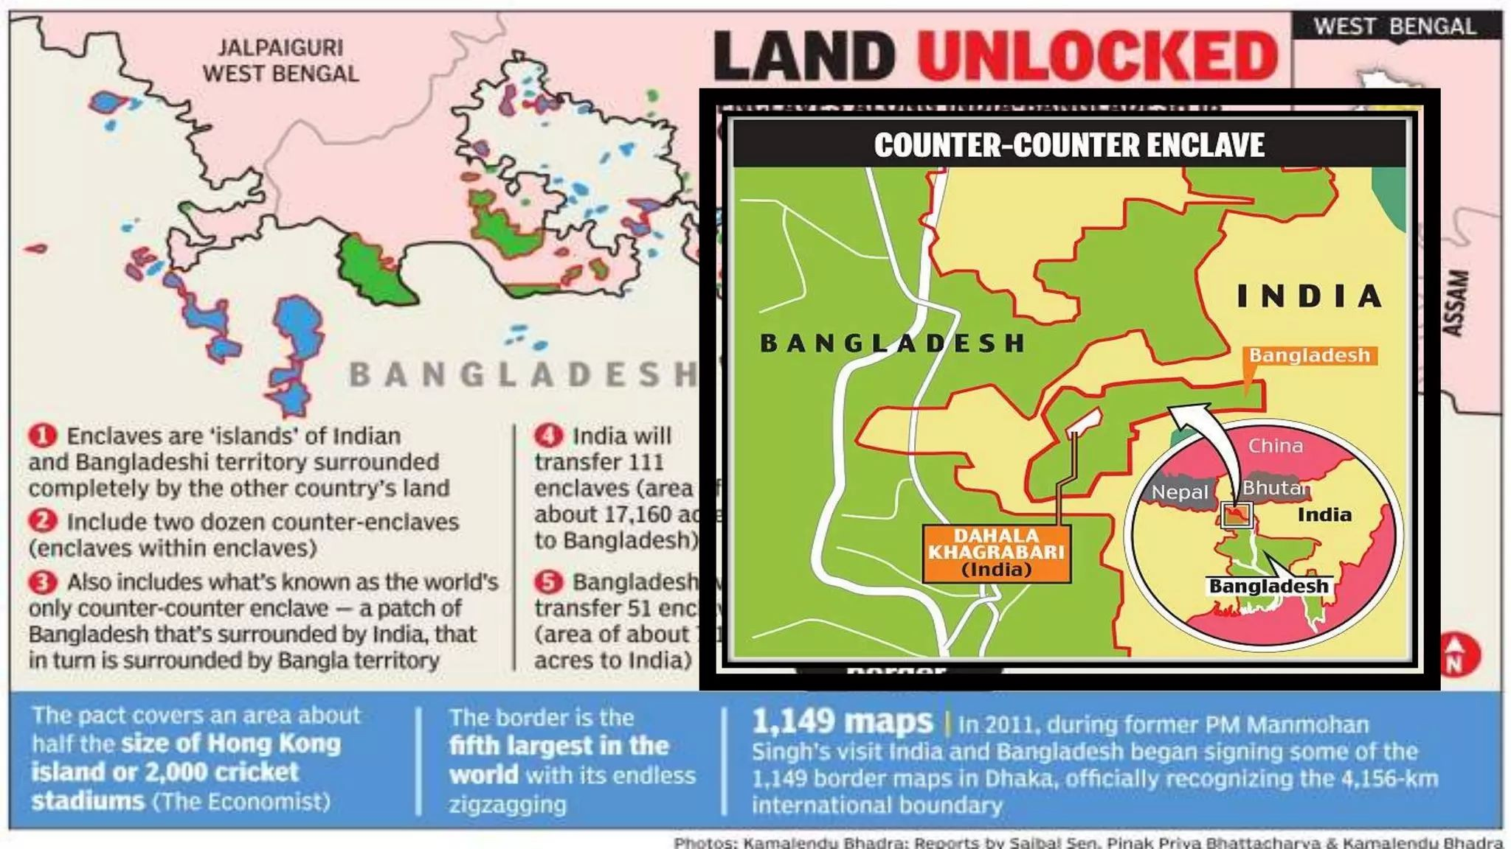

Slide 21


Slide 22
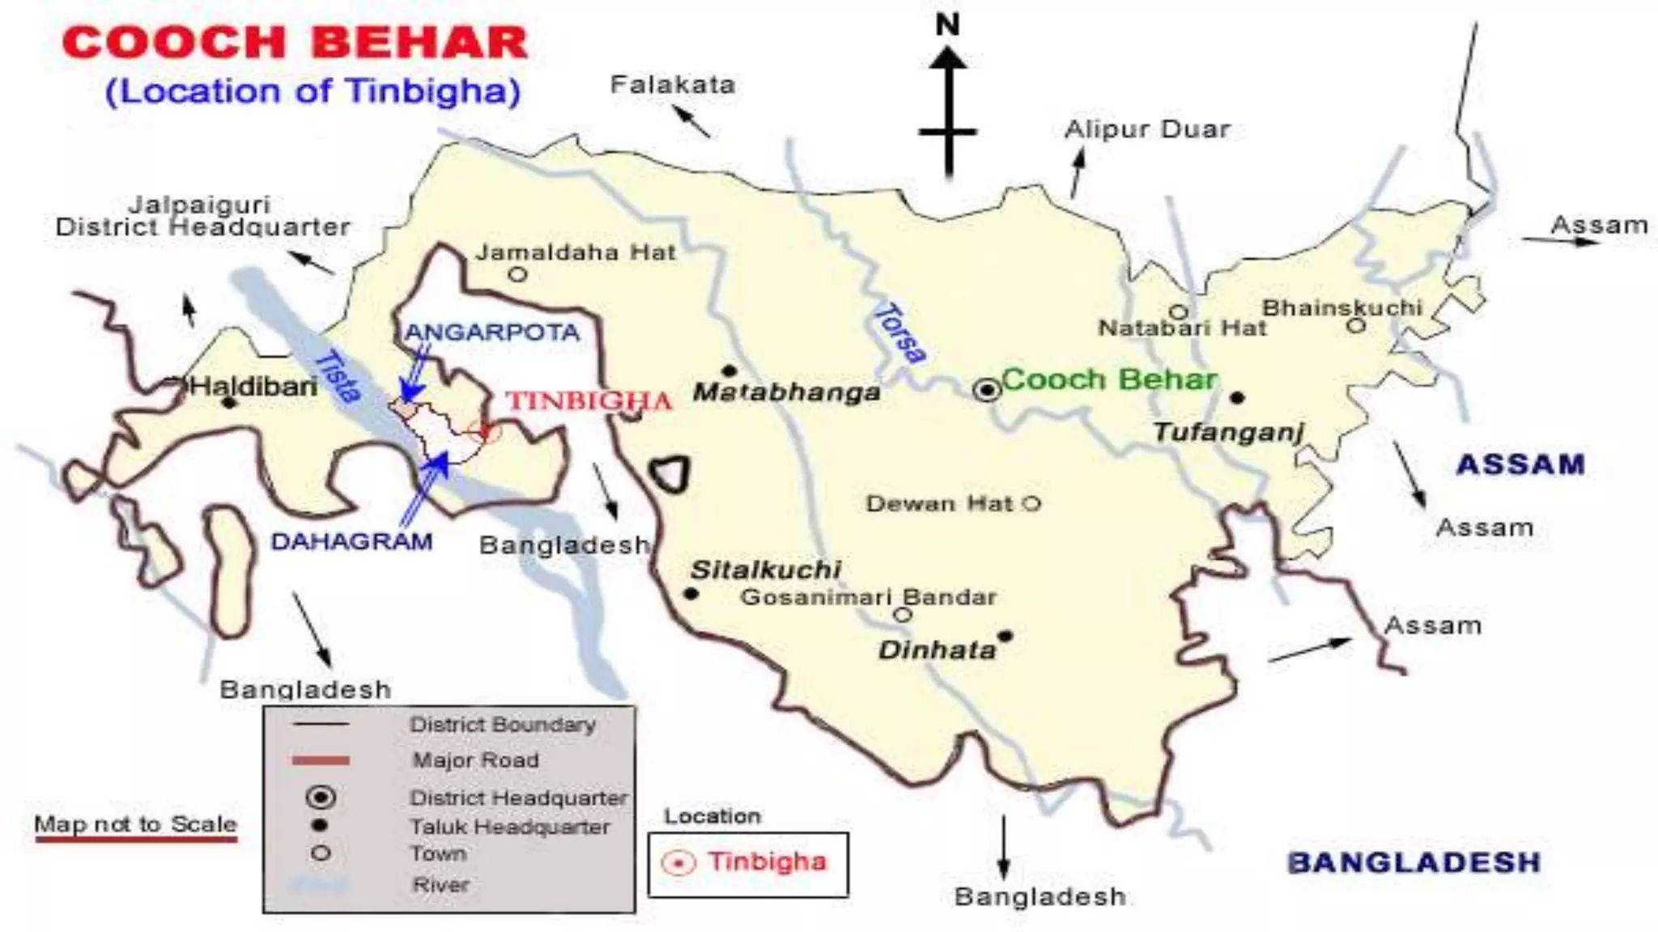

Slide 23
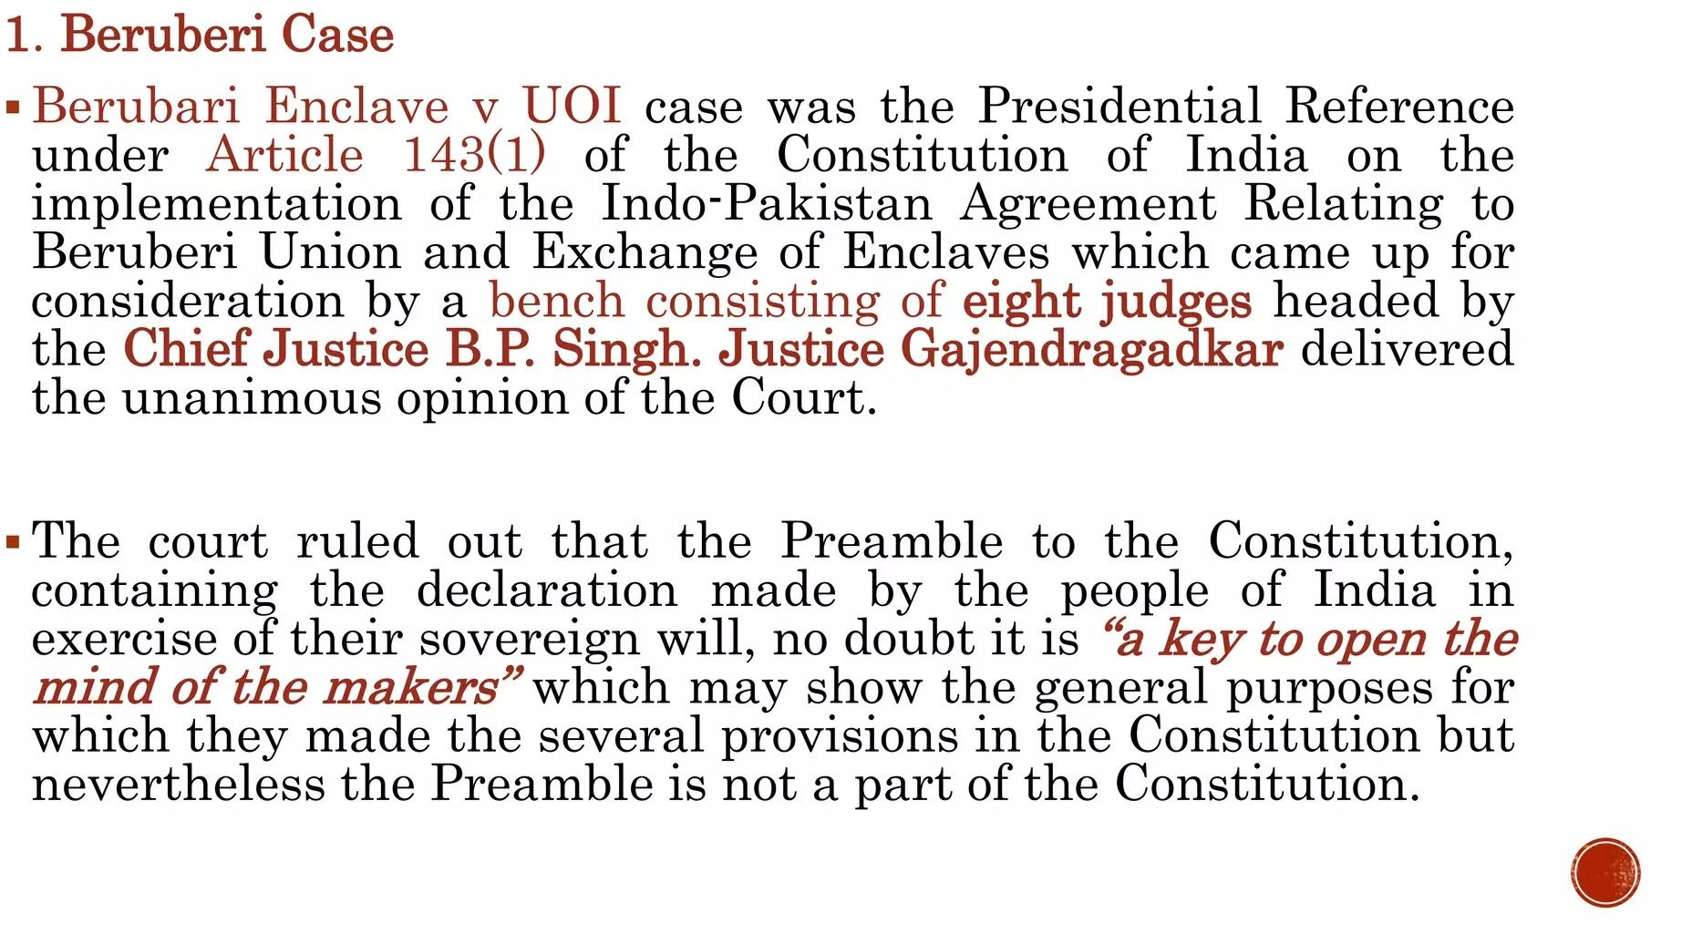

Slide 24
